Slide 1

Research Title: Roads defect detection using Image Annotation
Group member’s Name and ID:
1. Md Sehabub Zaman Pranta – 1611251042
2. Tanvir Ahmed – 1410982042

Slide 2
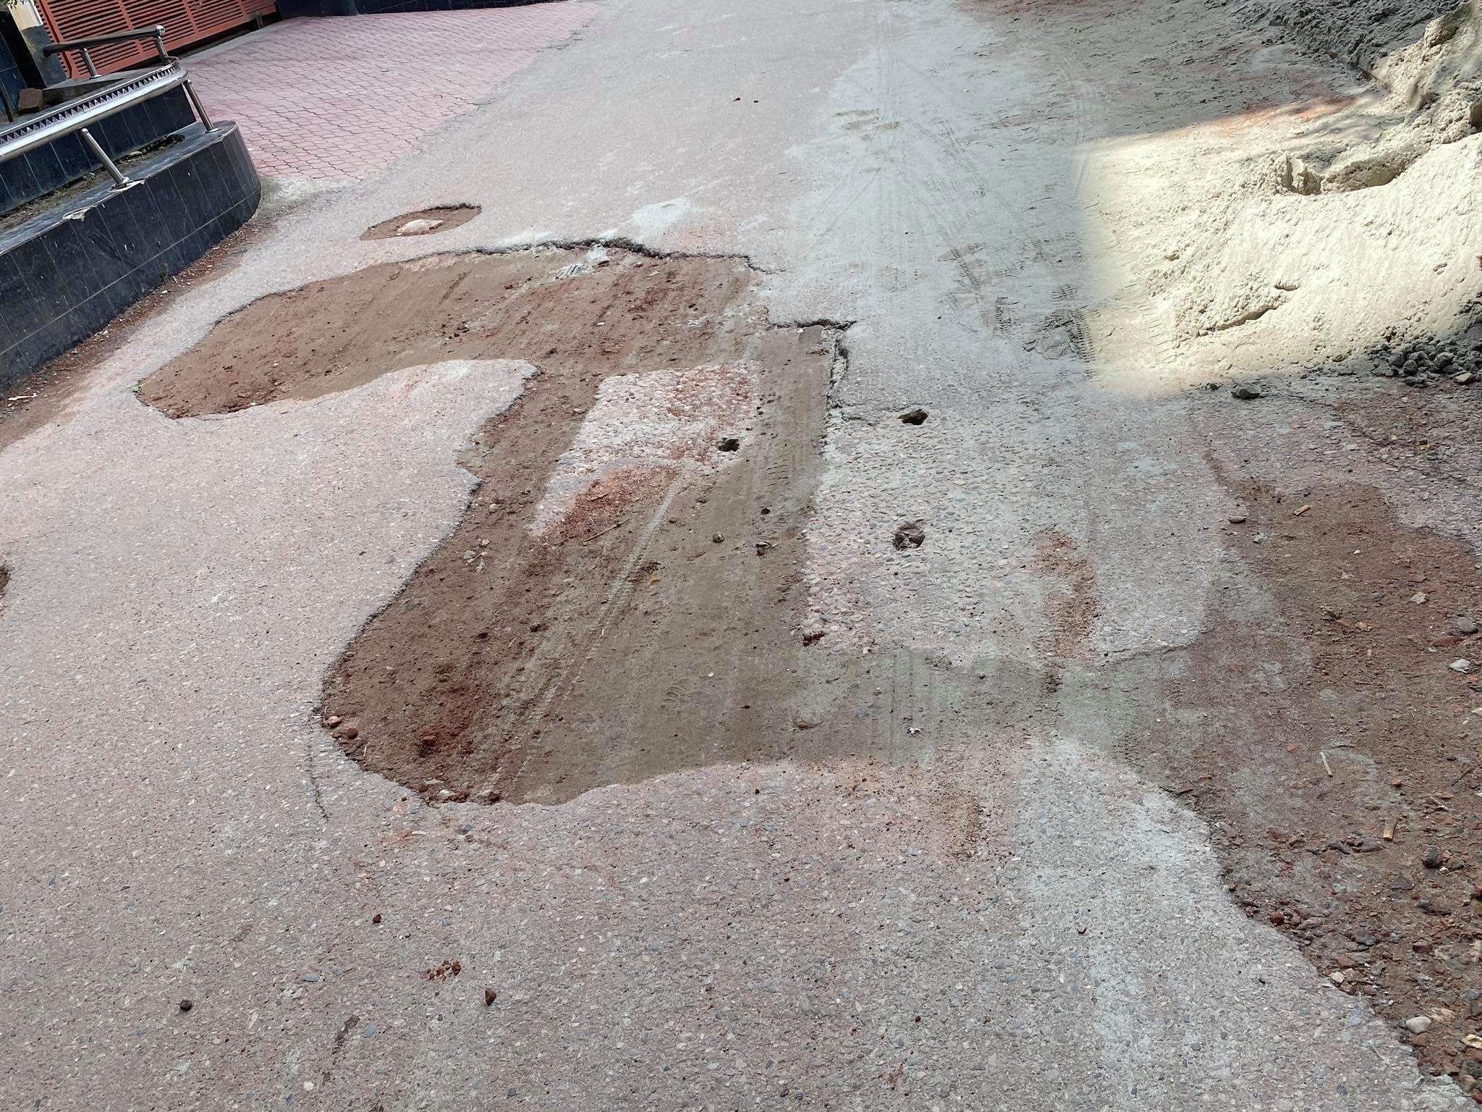
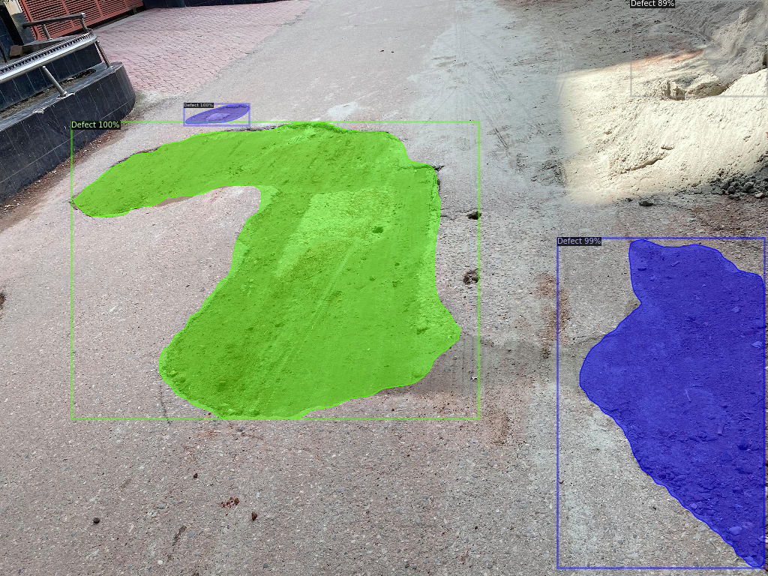
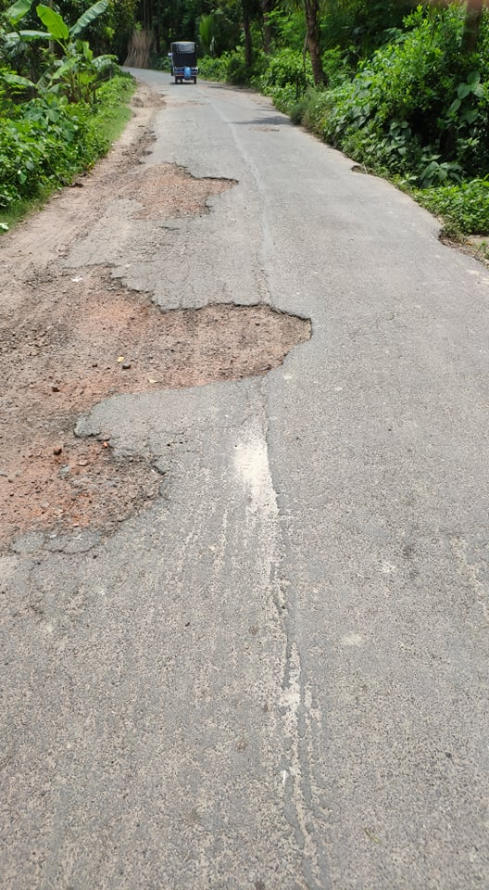
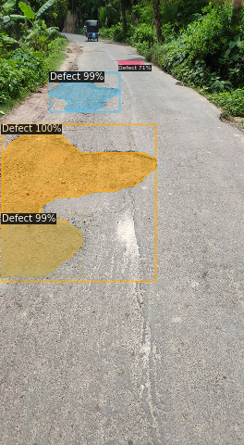
Batch size ⟶ 64

Slide 3
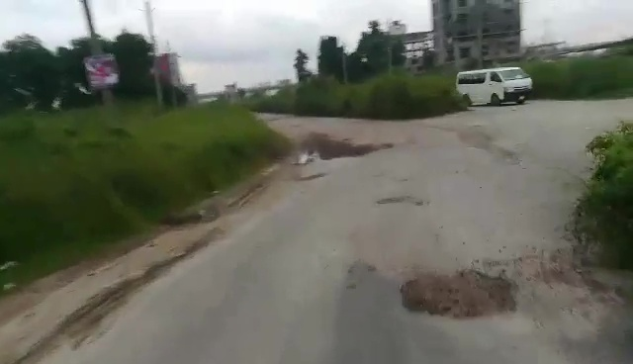
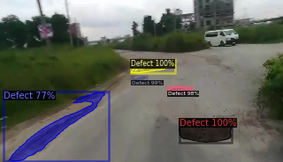
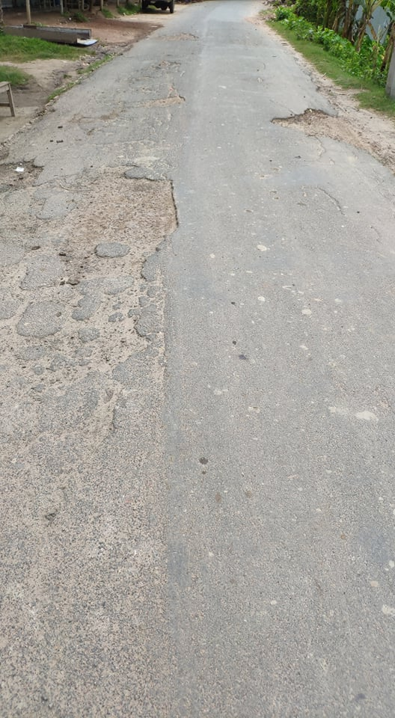
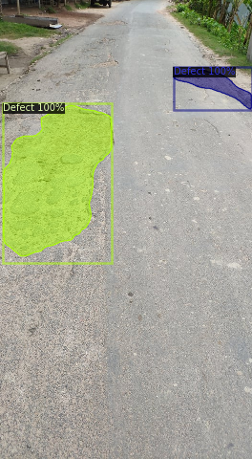
Batch size ⟶ 64

Slide 4
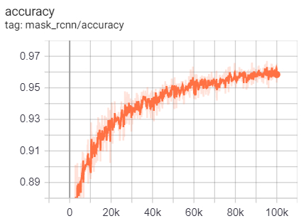
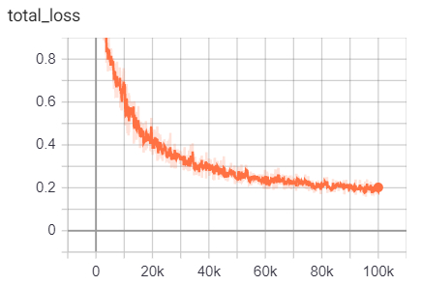
Batch size ⟶ 64
Batch size | AP | AP₅₀ | AP₇₅ | AP_{S} | AP_{M} | AP_{L}
64 | 25.700 | 50.884 | 21.666 | 12.453 | 24.968 | 29.970

Slide 5
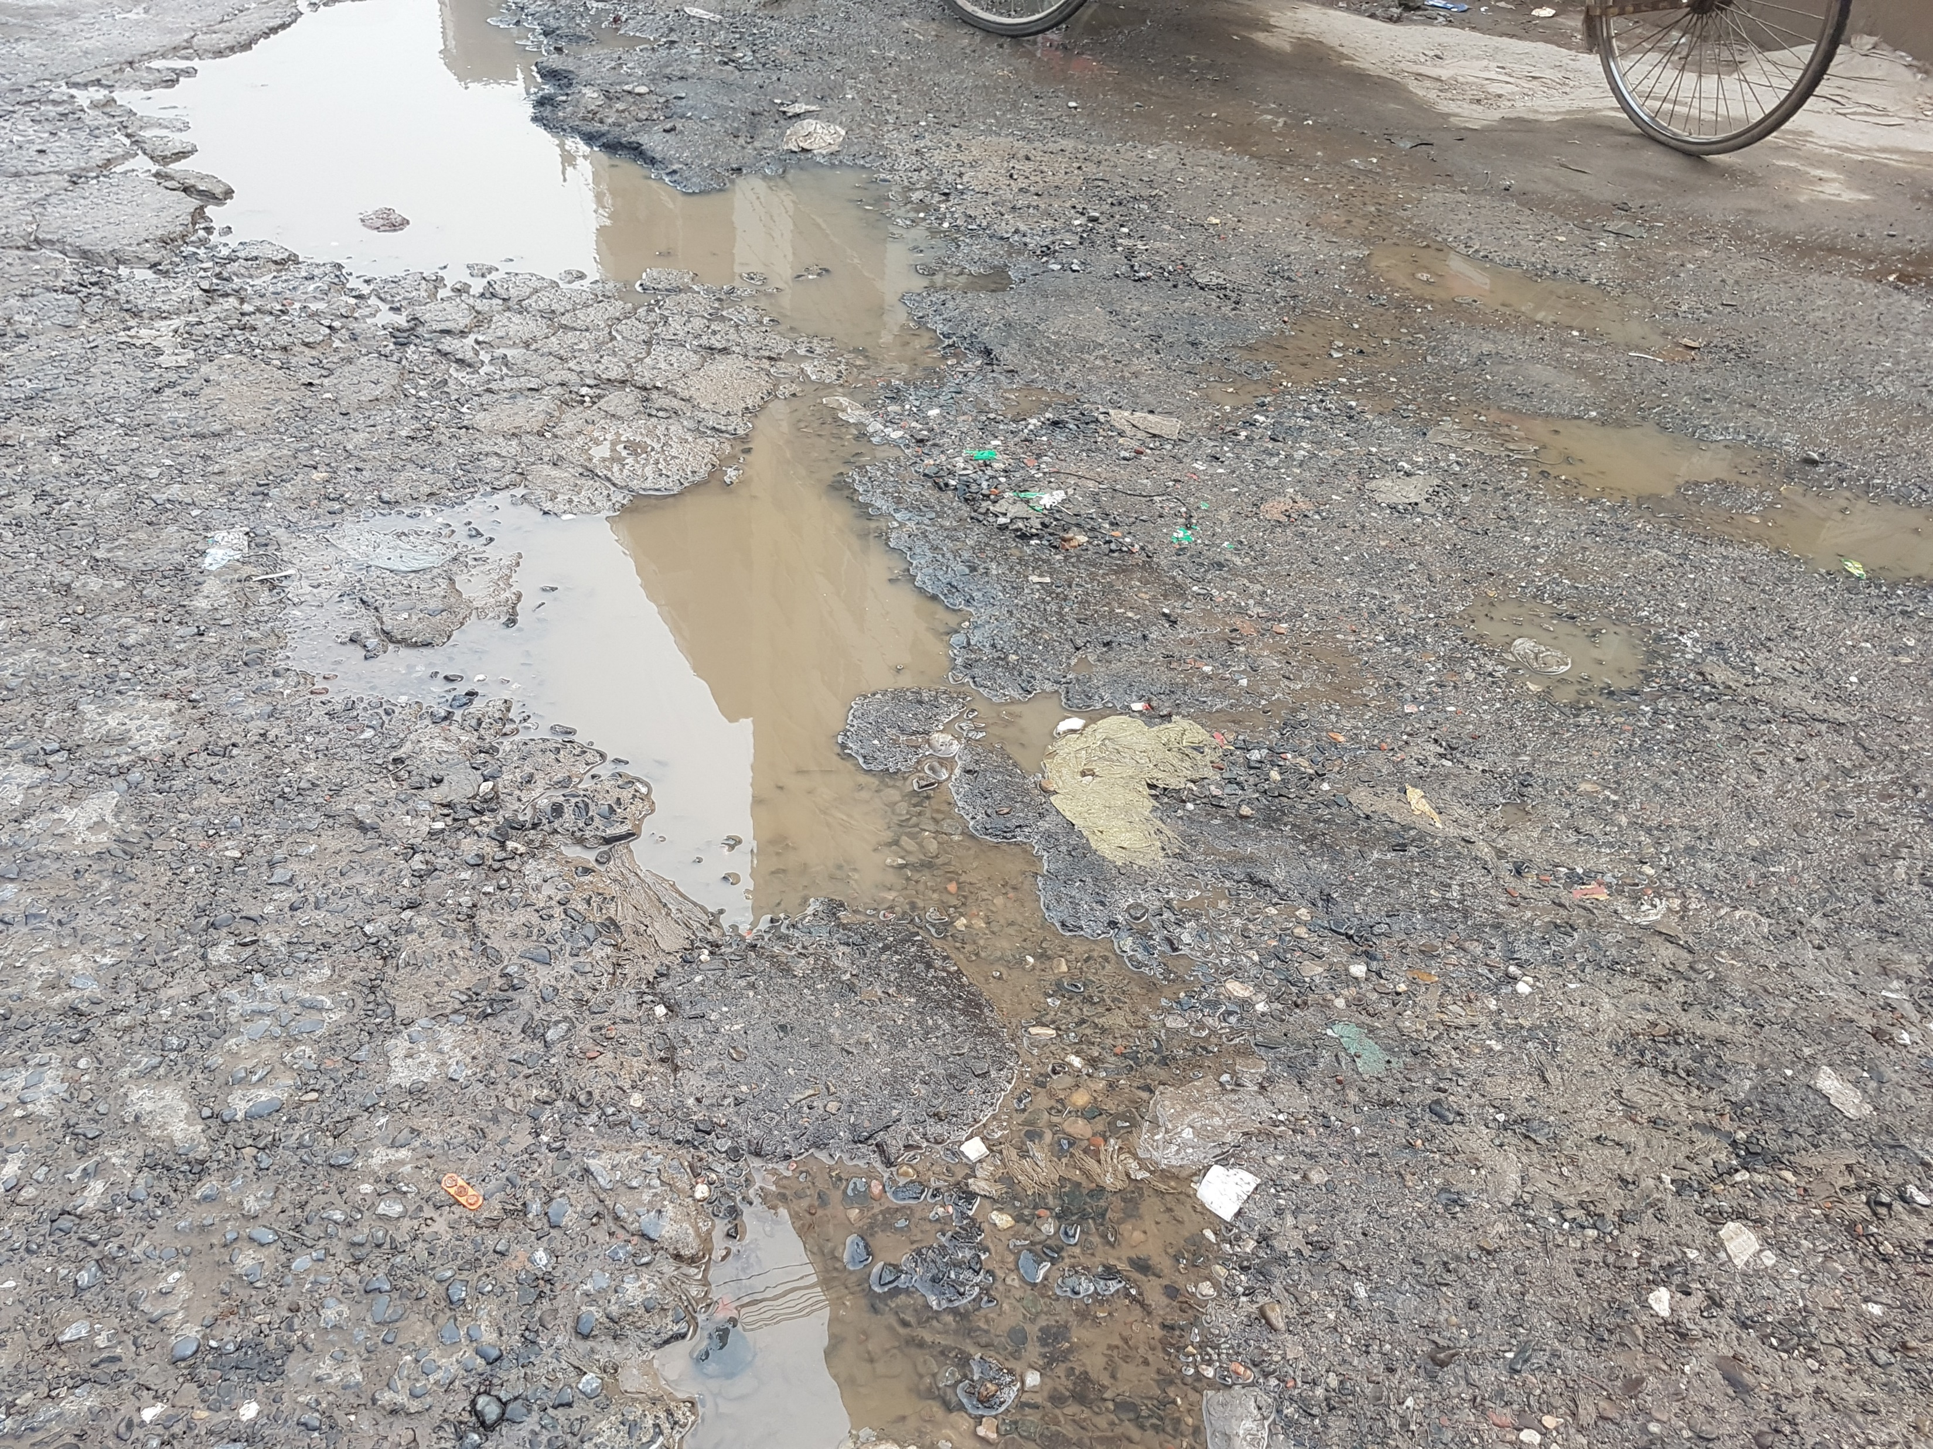
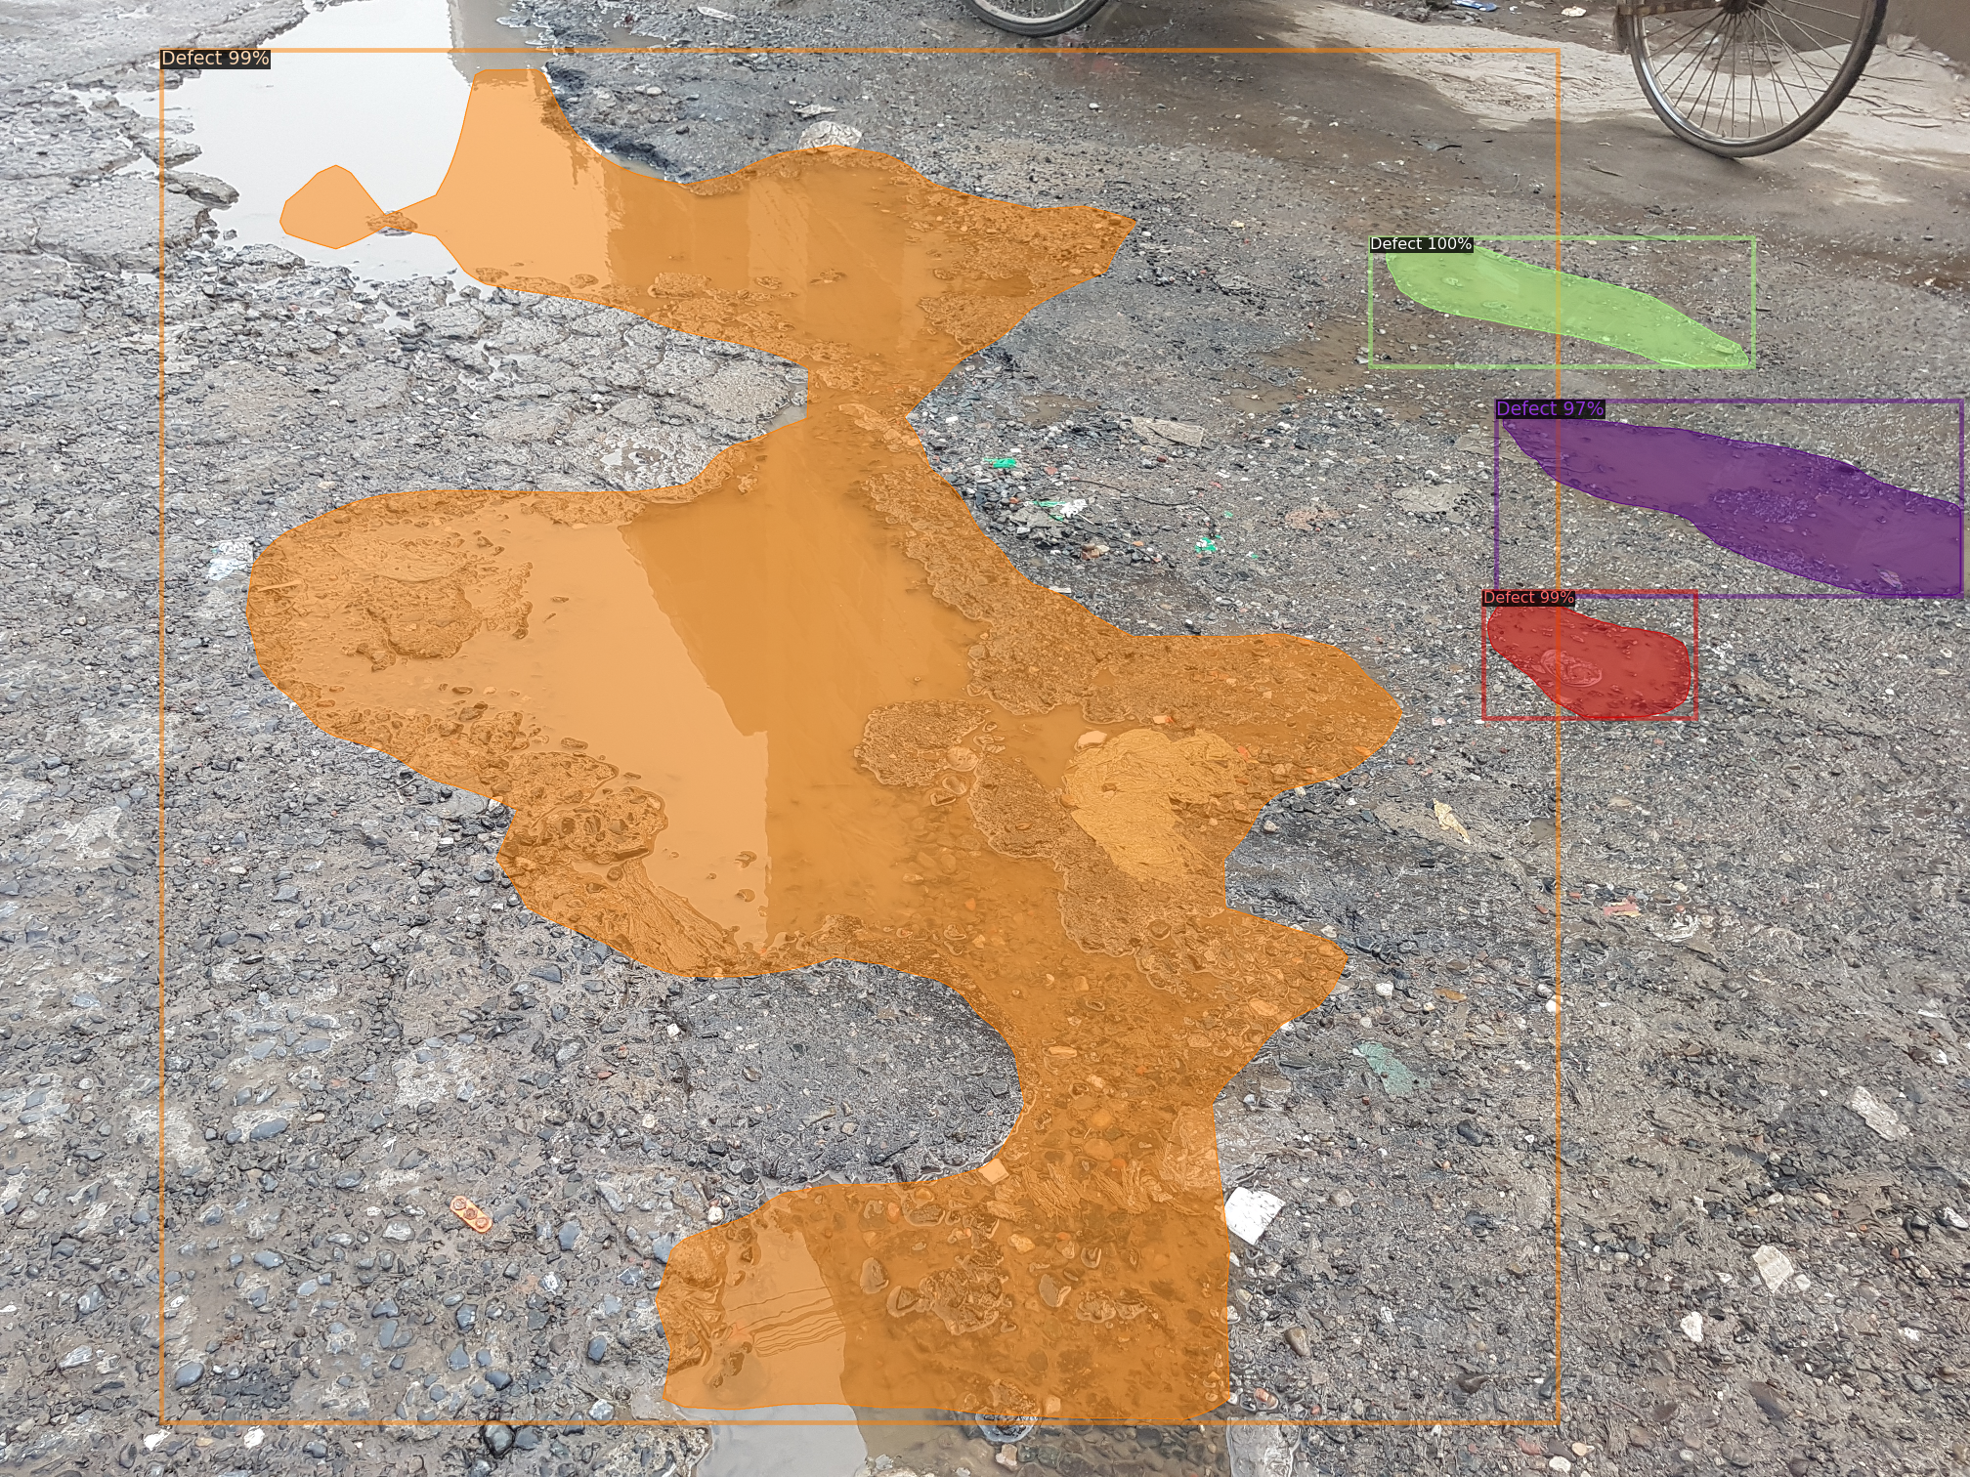
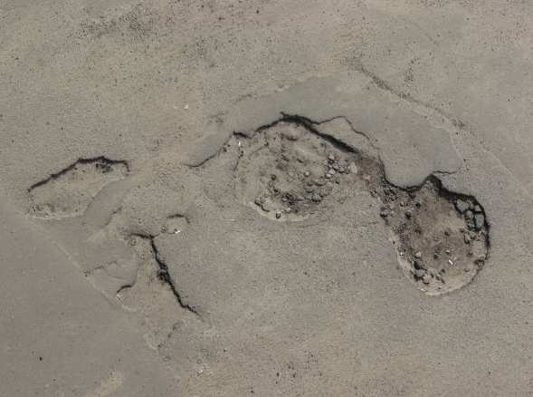
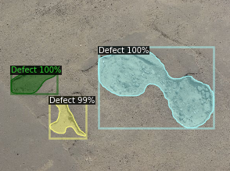
Batch size ⟶ 32

Slide 6
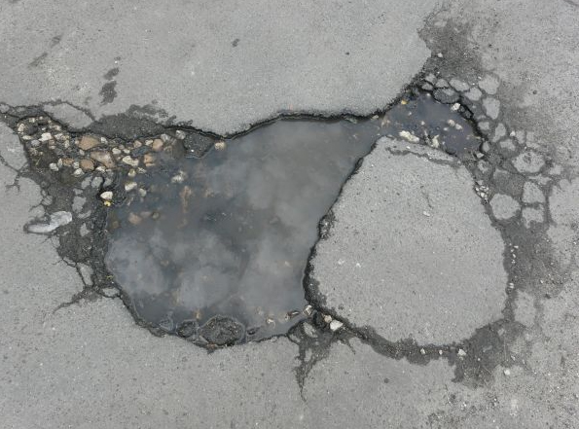
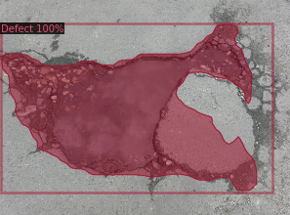
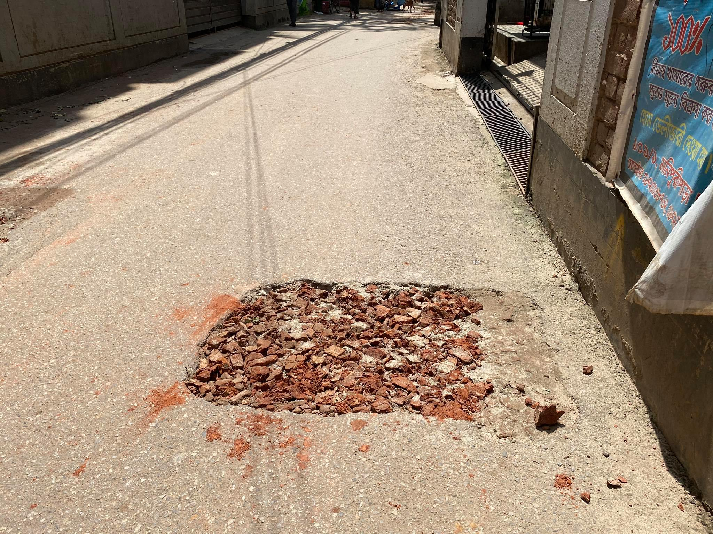
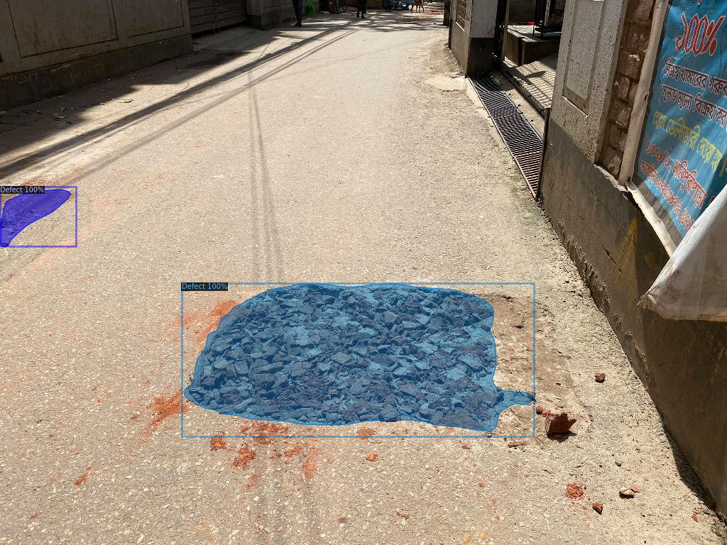
Batch size ⟶ 32

Slide 7
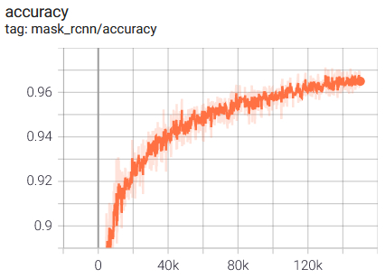
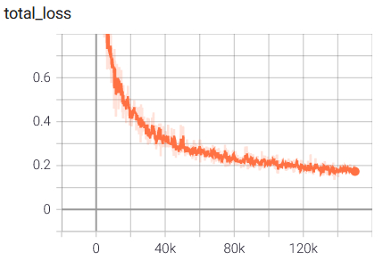
Batch size ⟶ 32
Batch size | AP | AP₅₀ | AP₇₅ | AP_{S} | AP_{M} | AP_{L}
32 | 27.633 | 52.892 | 24.187 | 13.534 | 28.723 | 31.481

Slide 8
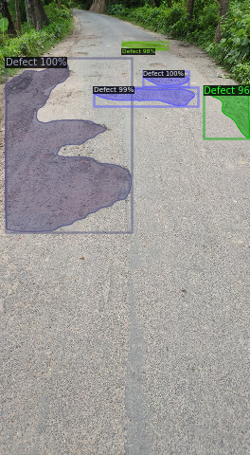
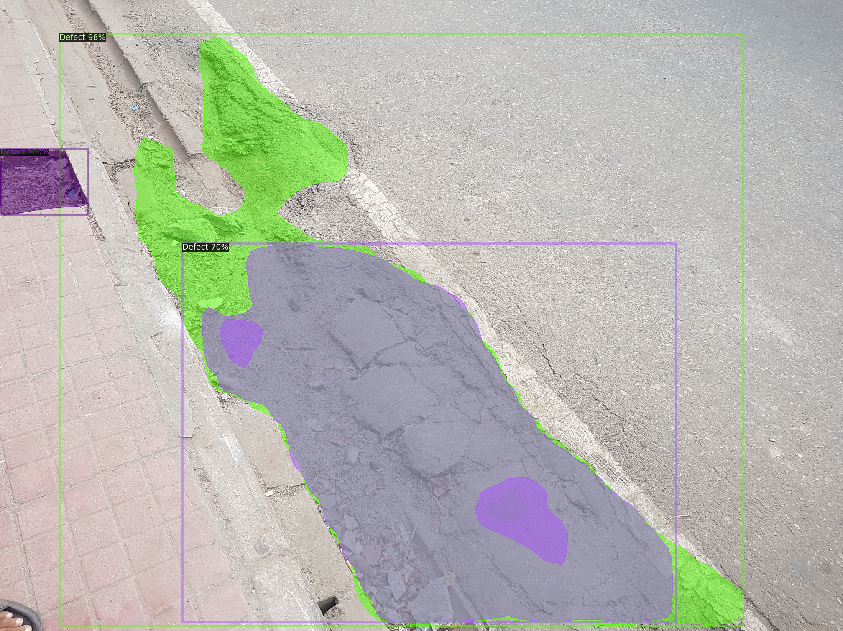
Batch size ⟶ 16

Slide 9
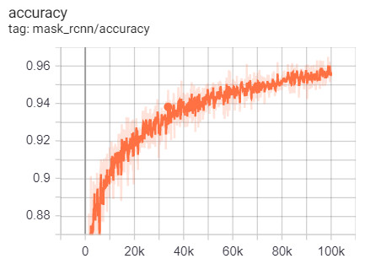
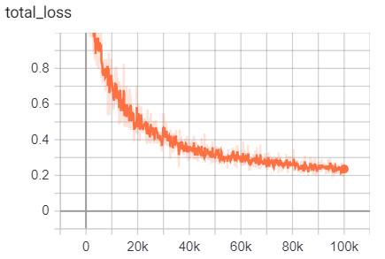
Batch size ⟶ 16
Batch size | AP | AP₅₀ | AP₇₅ | AP_{S} | AP_{M} | AP_{L}
16 | 27.120 | 52.725 | 22.992 | 12.958 | 27.004 | 31.596

Slide 10
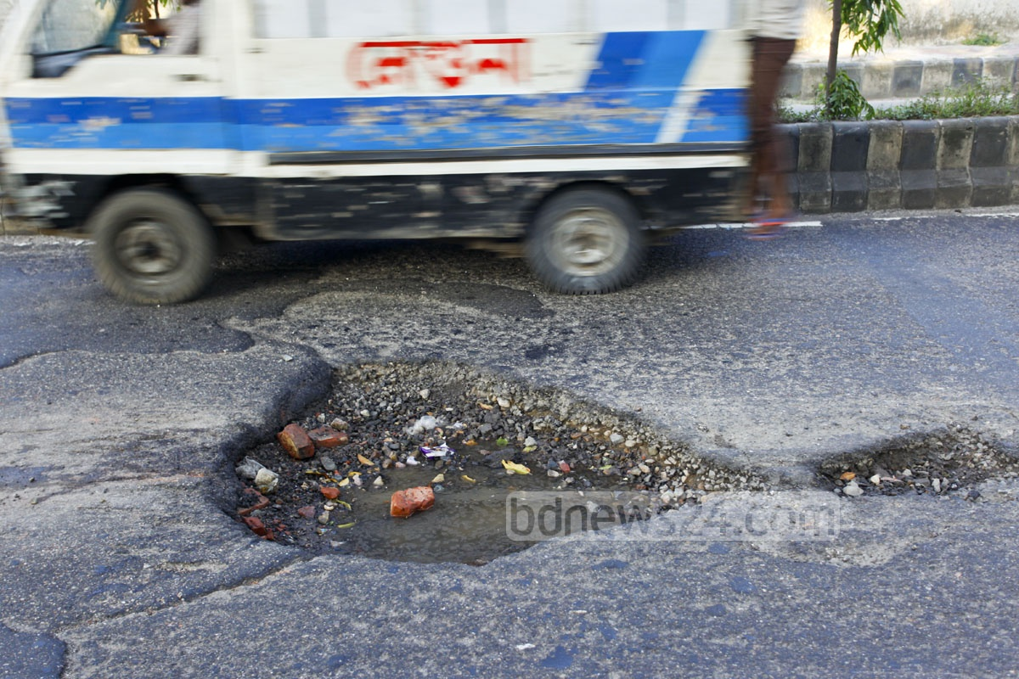
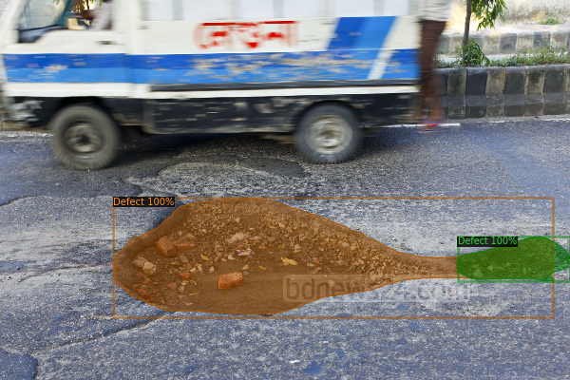
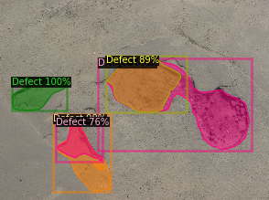
Batch size ⟶ 8

Slide 11
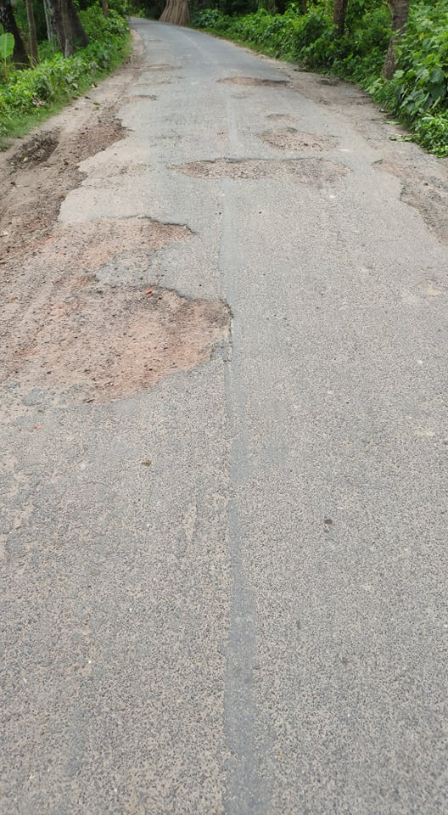
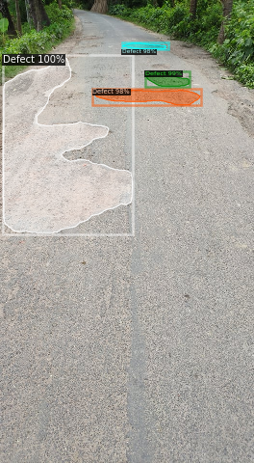
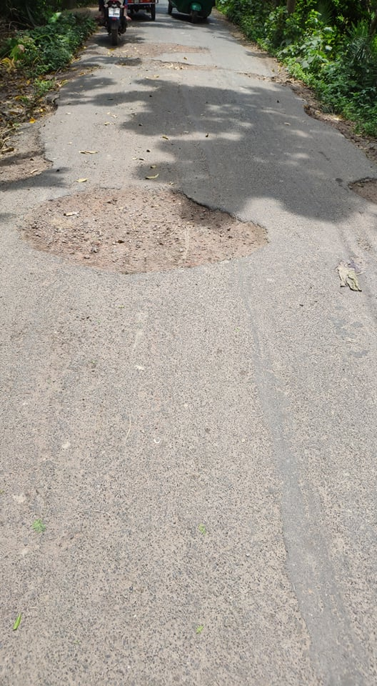
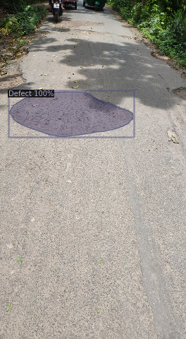
Batch size ⟶ 8

Slide 12
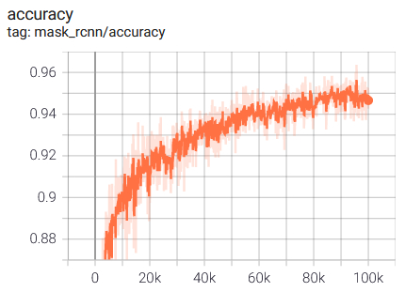
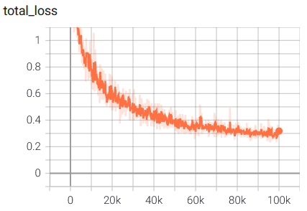
Batch size ⟶ 8
Batch size | AP | AP₅₀ | AP₇₅ | AP_{S} | AP_{M} | AP_{L}
8 | 26.601 | 53.221 | 23.477 | 15.999 | 24.441 | 31.350

Slide 13
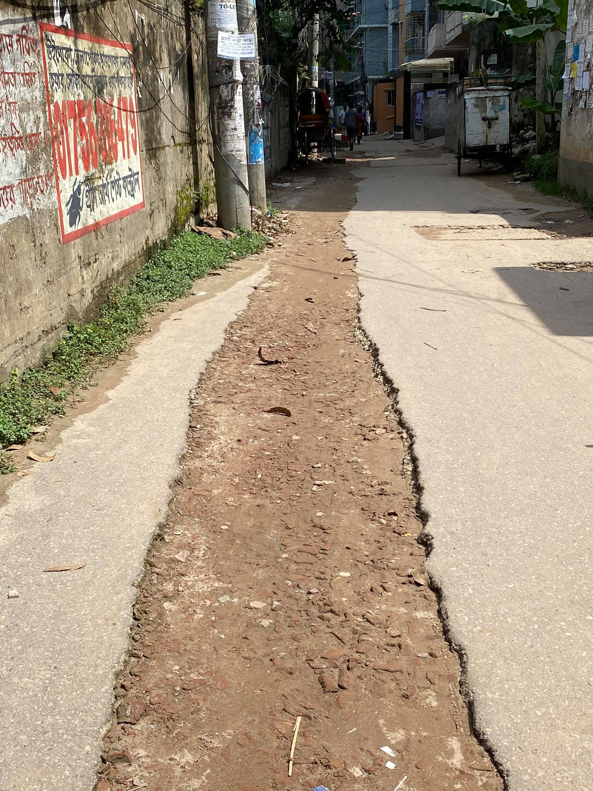
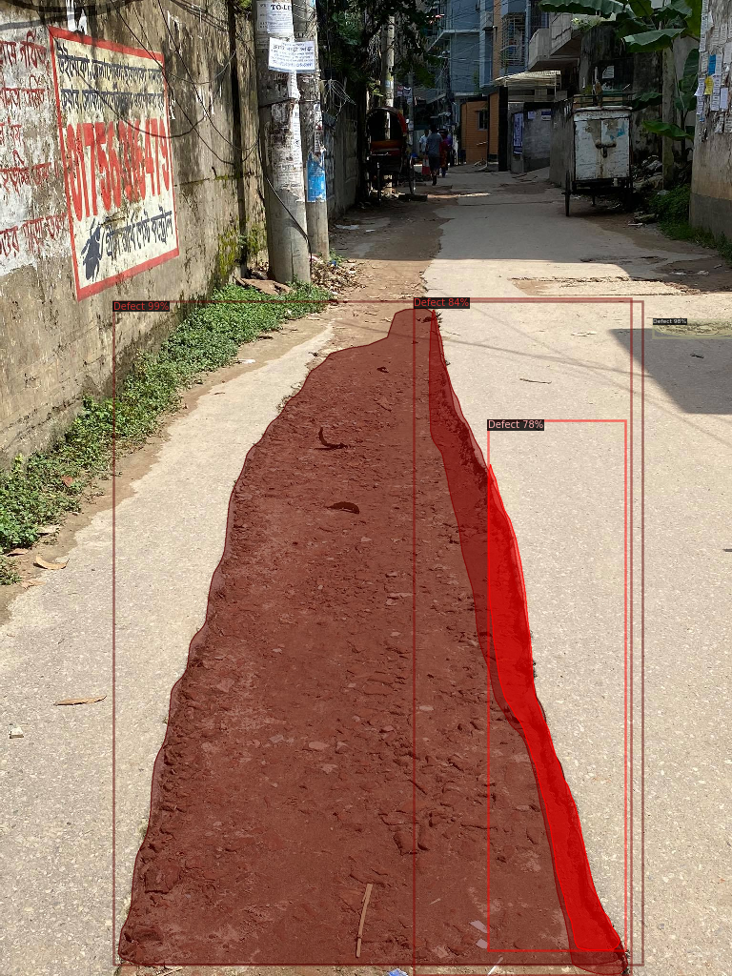
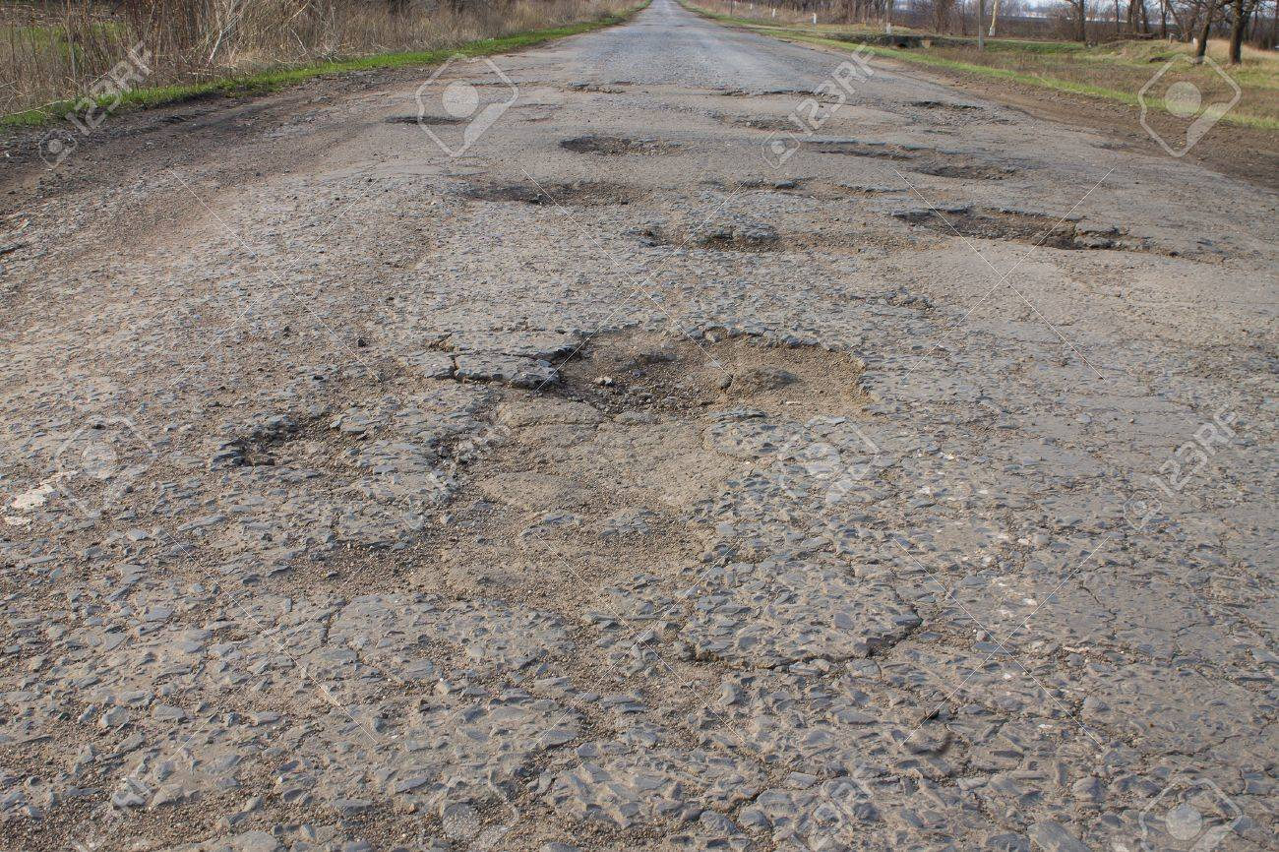
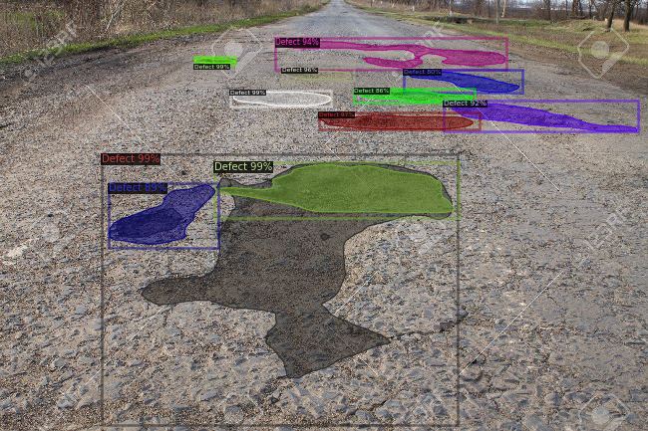
Batch size ⟶ 4

Slide 14
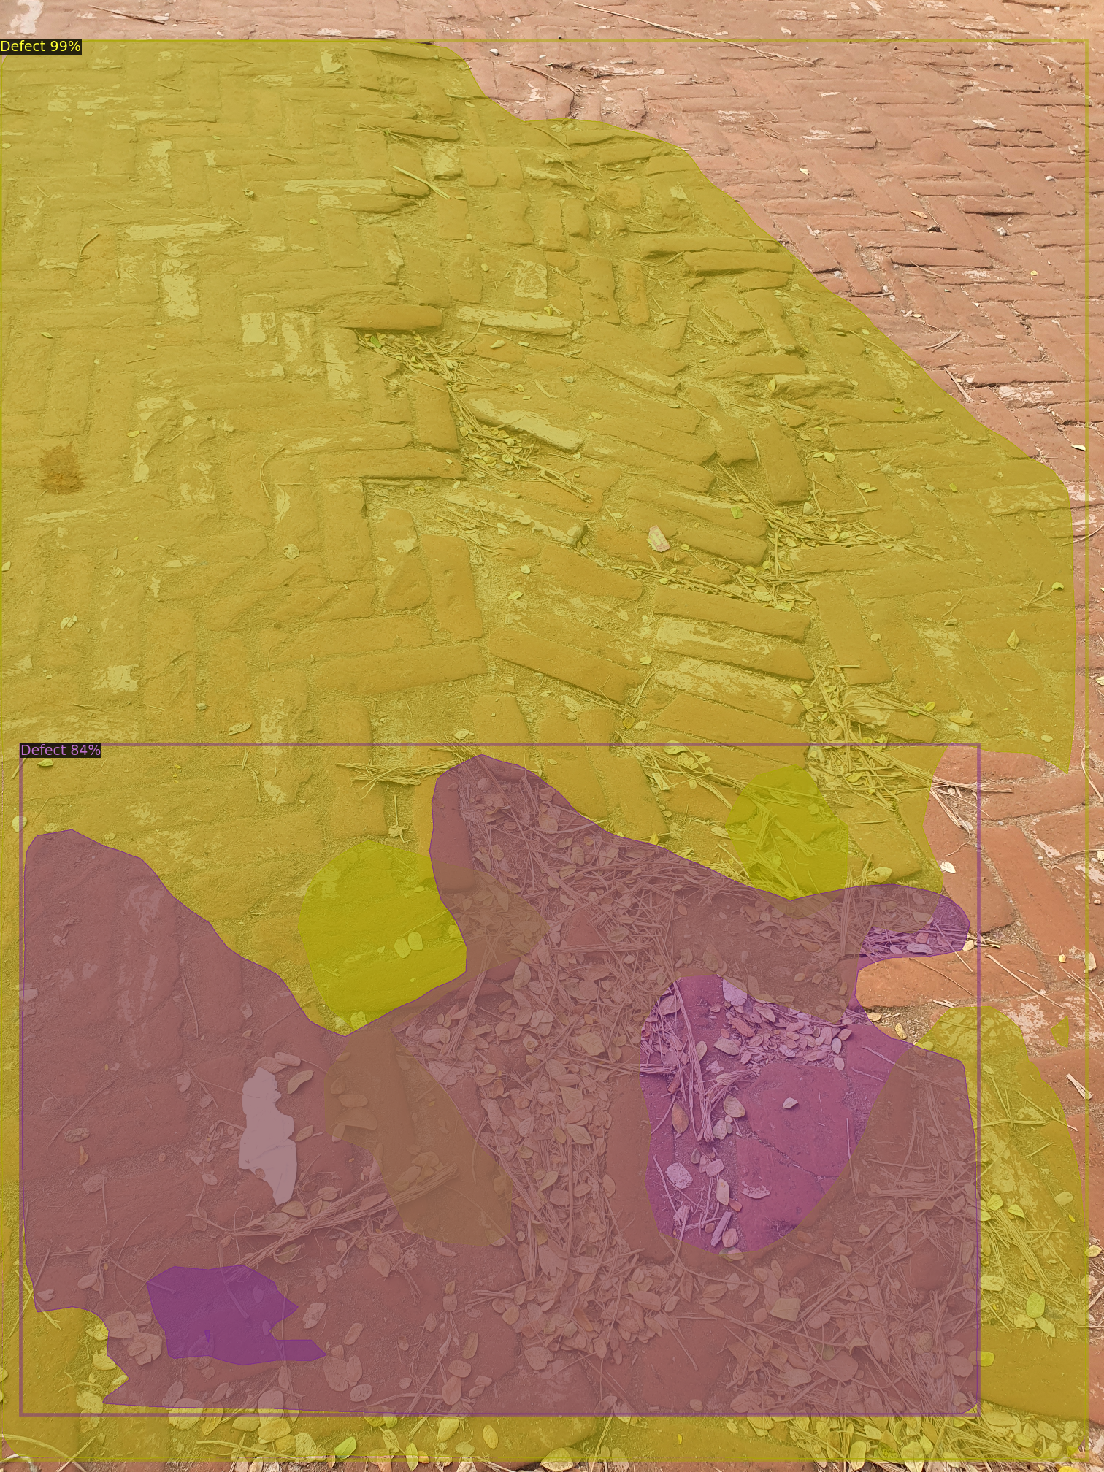
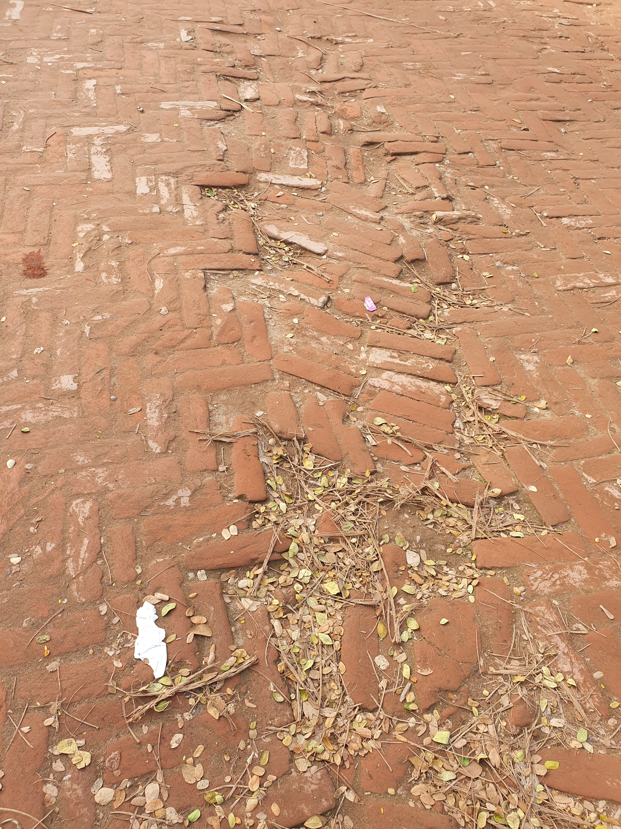
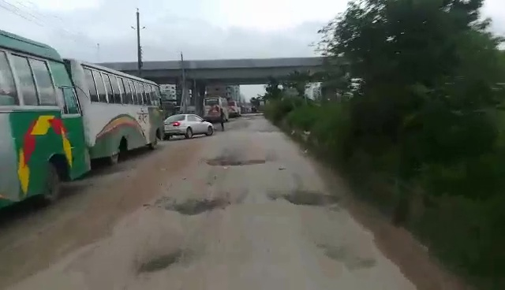
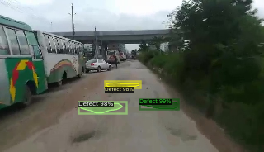
Batch size ⟶ 4

Slide 15
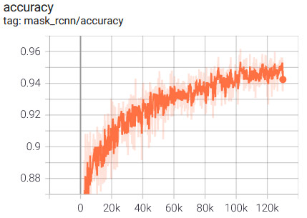
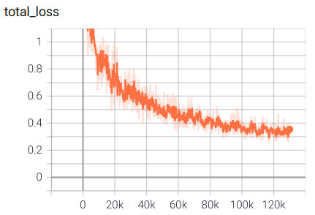
Batch size ⟶ 4
Batch size | AP | AP₅₀ | AP₇₅ | AP_{S} | AP_{M} | AP_{L}
4 | 28.110 | 55.028 | 25.047 | 14.784 | 26.824 | 34.167

Slide 16
Overall result
Batch size | Backbone | AP | AP₅₀ | AP₇₅ | AP_{S} | AP_{M} | AP_{L}
64 | ResNet-101-FPN | 25.700 | 50.884 | 21.666 | 12.453 | 24.968 | 29.970
32 | ResNet-101-FPN | 27.633 | 52.892 | 24.187 | 13.534 | 28.723 | 31.481
16 | ResNet-101-FPN | 27.120 | 52.725 | 22.992 | 12.958 | 27.004 | 31.596
8 | ResNet-101-FPN | 26.601 | 53.221 | 23.477 | 15.999 | 24.441 | 31.350
4 | ResNet-101-FPN | 28.110 | 55.028 | 25.047 | 14.784 | 26.824 | 34.167
Best Values

Slide 17
Overall result cont’d
Batch size | Backbone | AP | AP₅₀ | AP₇₅ | AP_{S} | AP_{M} | AP_{L}
64 | ResNet-101-FPN | 25.700 | 50.884 | 21.666 | 12.453 | 24.968 | 29.970
32 | ResNet-101-FPN | 27.633 | 52.892 | 24.187 | 13.534 | 28.723 | 31.481
16 | ResNet-101-FPN | 27.120 | 52.725 | 22.992 | 12.958 | 27.004 | 31.596
8 | ResNet-101-FPN | 26.601 | 53.221 | 23.477 | 15.999 | 24.441 | 31.350
4 | ResNet-101-FPN | 28.110 | 55.028 | 25.047 | 14.784 | 26.824 | 34.167
Best Values

